Slide 1

Building Modern Mobile Apps Native Android
Kevin E Ford
Mobile Practice Lead
Magenic
Level: Introductory

Slide 2
Kevin Ford
KevinF@magenic.com
@Bowman74
http://windingroadway.blogspot.com
https://github.com/Bowman74
BrentE@magenic.com
@brentledwards
http://www.brentedwards.net
https://github.com/brentedwards
Brent Edwards

Slide 3
Mobile Tasks Source Code
GitHub
https://github.com/brentedwards/MobileTasks

Slide 4
What is Native Android Development?

Slide 5
History
Created by Google
First Android beta SDK Launched Nov. 2007
1.0 Version by Sep 2008
Versions use named based theme
Android Studio Stable Released Dec 2014
Java is the Primary Language

Slide 6
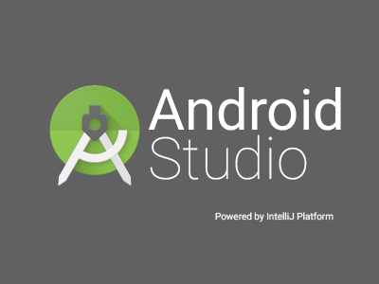



History of Android IDEs

Slide 8


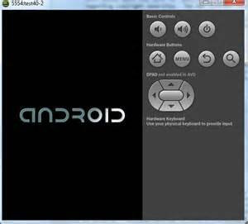

There are a lot of moving parts

Slide 9
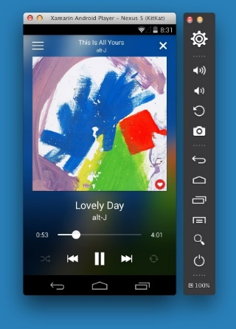
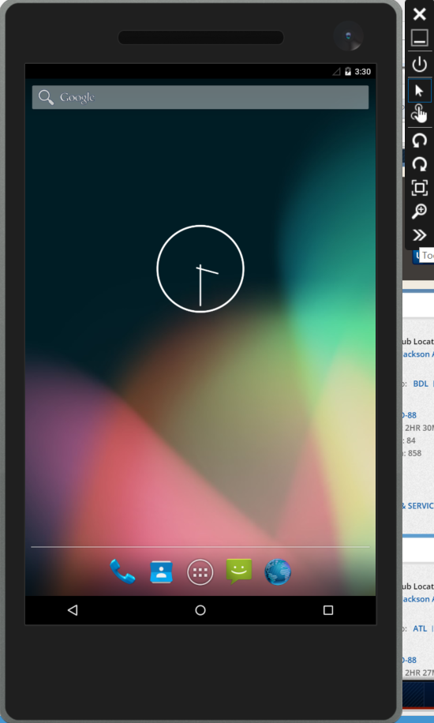
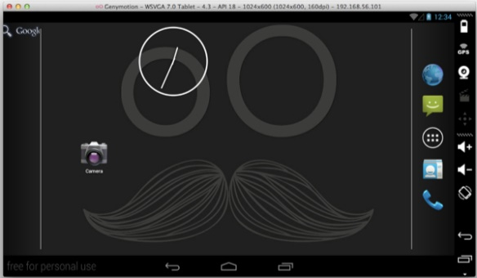
Emulator Options - Android
Mac OS with HAXM Atom
Windows with Hyper-V

Slide 10
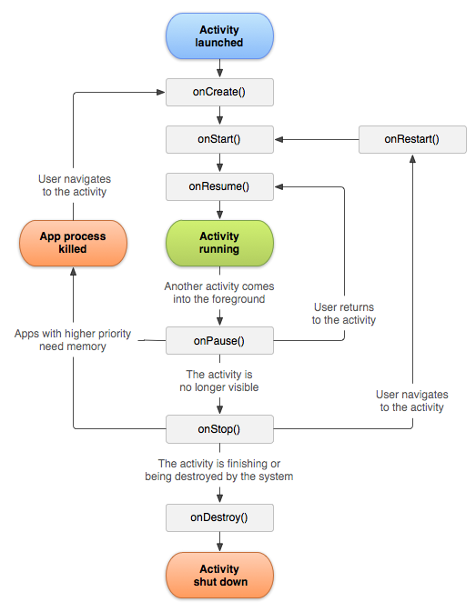
Lifecycle

Slide 11

Gradle

Slide 12
Activities and Intents
Activity 2
Activity 1
Activity 1

Slide 13
Android Foundational Concepts
Layouts
Controls
Styles

Slide 14
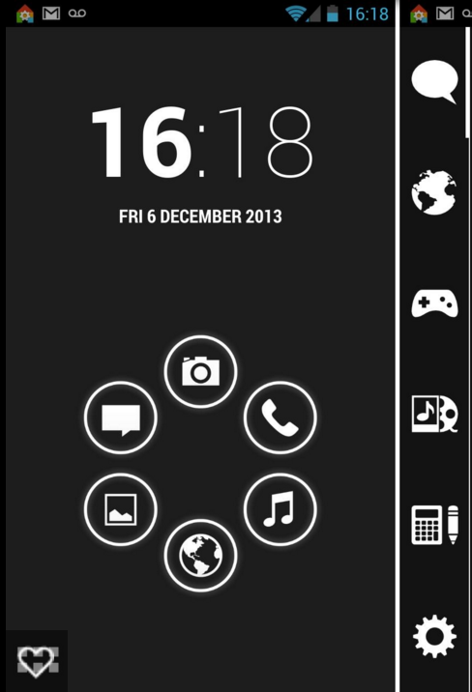
Layouts
Linear Layout
Relative Layout
Web View

Slide 15
Layouts with Adapters
List View
Grid View

Slide 16
Common Controls
Button
EditText
CheckBox
RadioButton
Switch
Spinner

Slide 17
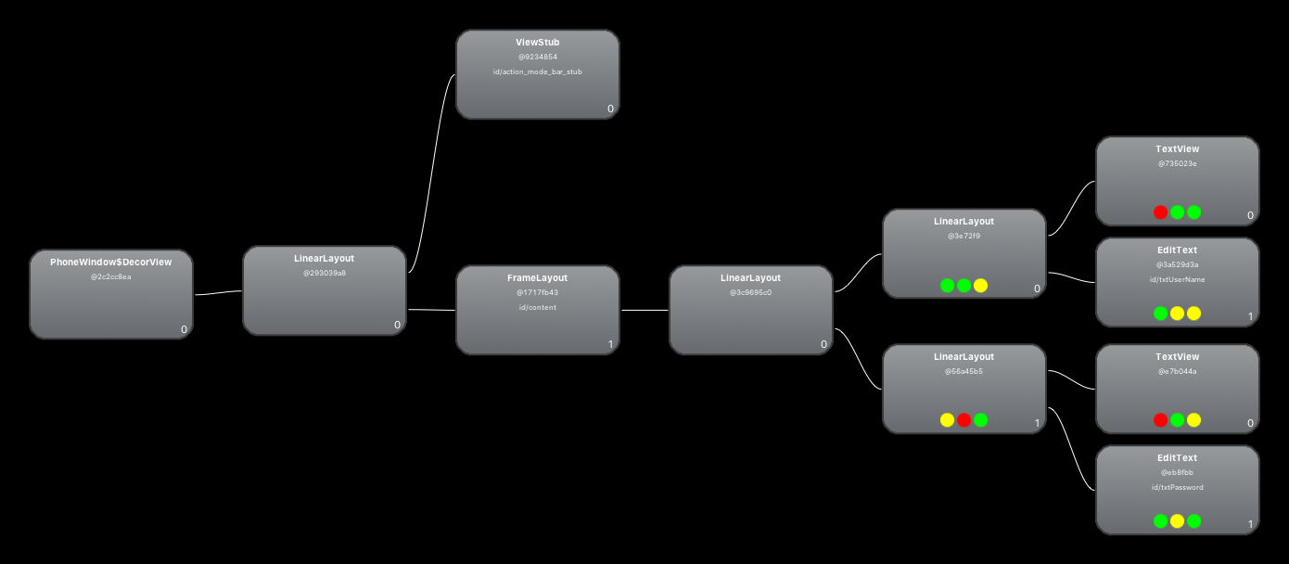
Hierarchal

Slide 18
Phones vs. Tablets
Single Binary
No True Differentiation
Adaptive Through Resources

Slide 19
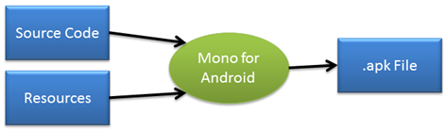
Resources
Contain Strings, Layouts, images, etc
Vary Based on Several Factors
Controlled by Directory Stricture
Language
Resolution
Orientation

Slide 20
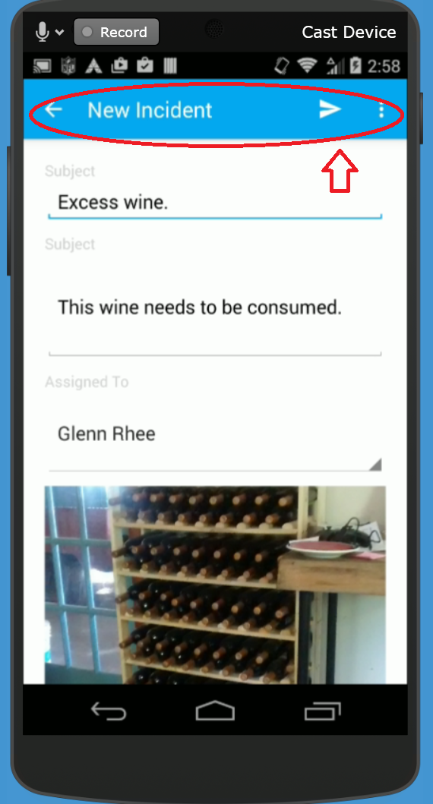
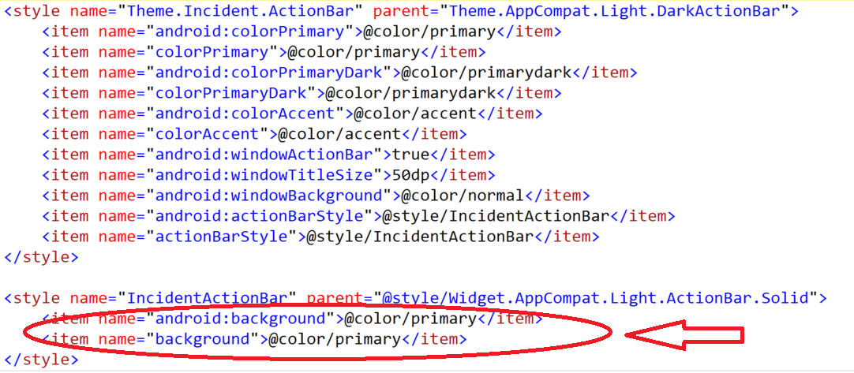
Android Styles

Slide 21
Connecting to Azure
Gradle Compile
com.microsoft.azure:azure-mobile-android:3.0
Async done via ListenableFuture
Json handling via GSon

Slide 22
Azure Authentication
public ListenableFuture authenticate (MobileServiceAuthenticationProvider provider) { ListenableFuture<MobileServiceUser> userFuture = networkSerice.getClient().login(provider); final MobileServiceAuthenticationProvider requestedProvider = provider; final SettableFuture result = SettableFuture.create(); Futures.addCallback(userFuture, new FutureCallback<MobileServiceUser>() { @Override public void onSuccess(MobileServiceUser user) { // Do Success Code result.set(null); } @Override public void onFailure(Throwable t) { result.setException(t); } });

Slide 23
When to use
Only targeting Android
Need latest features
Already know Java
Want a very stable Android development environment
Using third party tools designed for native toolsets

Slide 24
Conclusion
Excellent Choice For Android Only Environment
Android Studio Improved Development Performance
Fast Compile and Deploy Times
No Cross Platform Sharing Opportunities
Always can use the latest Android APIs
Can Develop on Windows and OSX

Slide 25
Questions?

